Slide 1
Unit 7 IMAGE SEGMENTATION
Presented By
Er.Harendra Bikram Shah
(Lecturer)
Department of Computer Engineering

Slide 2
OUTLINES
Introduction to Image Segmentation
Types of Image Segmentation
Edge or Boundary Linking and Detection
Spot and Line Detection

Slide 3
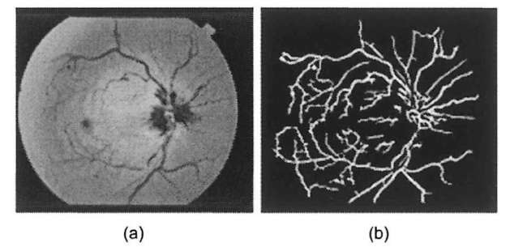
Introduction to Image Segmentation
Image segmentation is a task that involves dividing an image into meaningful and distinct regions or segments.
The goal is to simplify or change the representation of an image into something that is more meaningful and easier to analyze.
Image segmentation on the basis of two properties:
discontinuity
similarity
Applications:
Medical Imaging:
Autonomous Vehicles:
Satellite Image Analysis:
Robotics:
Video Surveillance:
Biometrics:
Agriculture:
Remote Sensing:

Slide 4
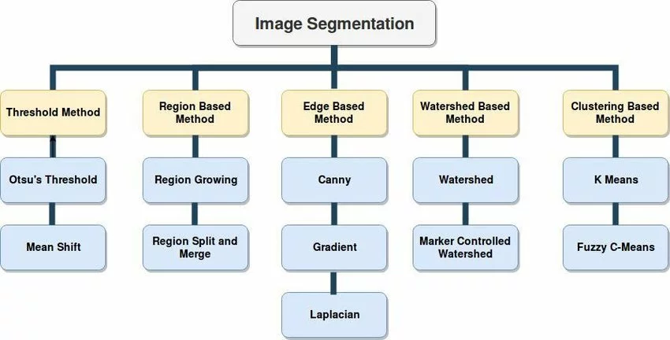
Image Segmentation Based on Similarity Properties
Thresholding: to separate objects or regions.
Region-Based Segmentation: Groups pixels based on their similar properties, like intensity, Color, or texture.
Edge-Based Segmentation: Identifies boundaries (edges) between different regions in an image.
Clustering-Based Segmentation: Groups pixels into clusters based on their similarity in feature space.
Watershed Segmentation: uses topographic information to divide an image into multiple segments or regions.

Slide 5
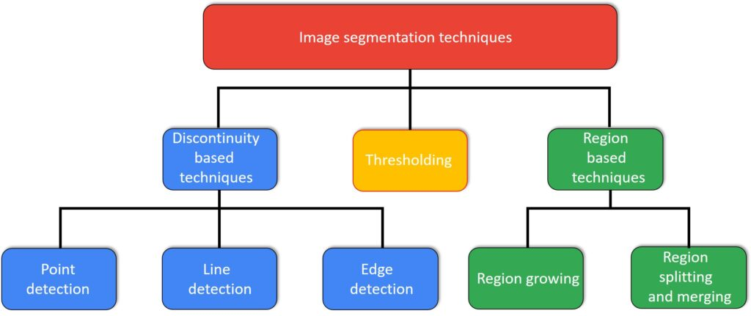
Image Segmentation Based on Dissimilar Properties

Slide 6
Image Segmentation Based on Dissimilar Properties
Uses information about edges in an image to sketch boundaries between different regions or objects.
Edges are areas where there are significant changes in intensity or Color, and identifying them is crucial for image segmentation.
Edge Detection : edge detection algorithms to highlight areas of rapid intensity changes.
Common edge detection methods include:
Using Mask(Operator):
Sobel Operator:
Prewitt Operator:
Robert Operator
Template Matching
Compass Operator
Edge Linking:
Connect the detected edge points to form continuous curves or contours.
Techniques for edge linking include Hough Transform, region-growing, and chain codes.
Hough Transform, for example, can be used to link edge points into lines or curves by identifying common parameters.

Slide 7
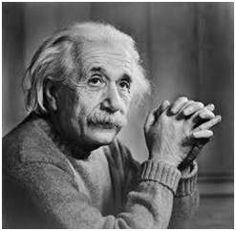
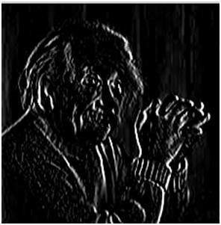
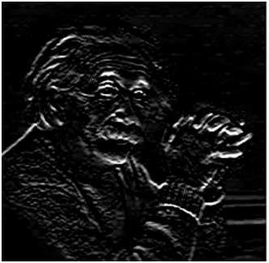
Prewitt operator
Prewitt operator is used for edge detection in an image.
It detects two types of edges
Horizontal edges
Vertical Edges
Edges are calculated by using difference between corresponding pixel intensities of an image.
Vertical direction
Horizontal Direction
-1 | 0 | 1
-1 | 0 | 1
-1 | 0 | 1
-1 | -1 | -1
0 | 0 | 0
1 | 1 | 1

Slide 8
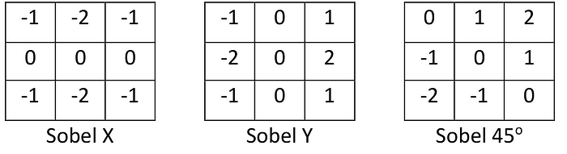
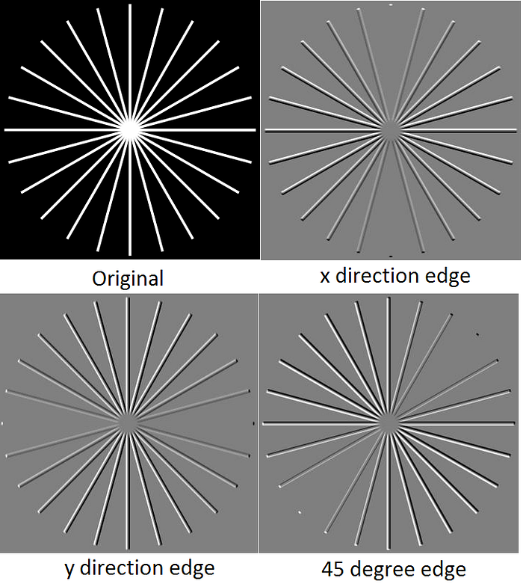
The Sobel operator
The Sobel operator the coefficients of masks are not fixed and they can be adjusted according to our requirement unless they do not violate any property of derivative masks.
It detects two types of edges
Horizontal edges
Vertical Edges
Edges are calculated by using difference between corresponding pixel intensities of an image.

Slide 9
Robert Operator
The Robert Operator is a simple edge detection operator used in image processing and computer vision.
It is named after Lawrence Roberts, who introduced it in the 1960s.
The Robert Operator is designed to detect edges by approximating the gradient of the image intensity.
Vertical Mask of Robert Operator:
Horizontal Mask of Robert Operator
+1 0
0 -1
0 +1
-1 0
Advantages:
simple and efficient.
detecting edges with a clear diagonal orientation.
Disadvantages:
It is sensitive to noise due to the small size of the convolution kernels.
may not perform well in the presence of diagonal edges in multiple directions.

Slide 10
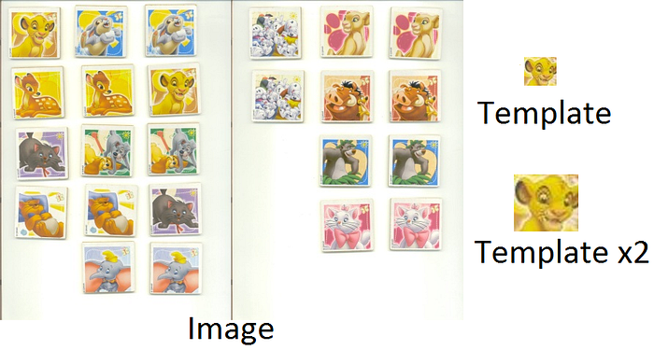
Template Matching
Template matching is used for detecting patterns or objects within an image.
template matching can be used to identify specific patterns or structures that represent edges.

Slide 11
III.COMPASS OPERATOR
The Compass Operator, also known as the Compass Edge Detector, is an edge detection technique that employs a set of masks or filters based on different compass directions (cardinal and intercardinal directions, like north, northeast, east, etc.).
Each filter is designed to capture information about intensity changes in a specific direction.
The Compass Operator is especially useful for detecting edges that have different orientations.
North Direction Mask
North West Direction Mask
-1 | 0 | 1
-1 | 0 | 1
-1 | 0 | 1
0 | 1 | 1
-1 | 0 | 1
-1 | -1 | 0

Slide 12
III.COMPASS OPERATOR
West Direction Mask
South West Direction Mask
South Direction Mask
1 | 1 | 1
0 | 0 | 0
-1 | -1 | -1
1 | 1 | 0
1 | 0 | -1
0 | -1 | -1
1 | 0 | -1
1 | 0 | -1
1 | 0 | -1
South East Direction Mask
East Direction Mask
North East Direction Mask
-1 | -1 | -1
0 | 0 | 0
1 | 1 | 1
-1 | -1 | 0
-1 | 0 | 1
0 | 1 | 1
0 | -1 | -1
1 | 0 | -1
1 | 1 | 0

Slide 13
Line/Curve and Spot/Point Detection
Line detection in image processing involves identifying and extracting straight lines from an image.
It is Detected by Using Second Order Derivative Filter
+45⁰
Vertical Filter
-45⁰
Horizontal Filter
-1 | -1 | -1
2 | 2 | 2
-1 | -1 | -1
2 | -1 | -1
-1 | 2 | -1
-1 | -1 | 2
-1 | 2 | -1
-1 | 2 | -1
-1 | 2 | -1
-1 | -1 | -2
-1 | 2 | -1
2 | -1 | -1
Spot/Point Detection
Spot detection in image processing refers to identifying small, well-defined regions or points within an image.
-1 -1 -1
-1 8 -1
-1 -1 -1

Slide 14
Hough Transform
The Hough Transform is a technique used for detecting shapes, particularly in image analysis.
It was originally developed by Paul Hough in 1962
Used for detecting lines in binary images, other shapes such as circles and ellipses.
Use of Hough Transform:
Edge Detection:
Object Recognition:
Medical Imaging:
Robotics and Computer Graphics:
Lane Detection in Autonomous Vehicles:

Slide 15
End of UNIT 7

Slide 16
THANK YOU

